Slide 1
Alkanes and cyclo alkanes
Dr.Entissar Alshaway

Slide 2
Learning objectives
1-Define of Hydrocarbons.
2-General classification of hydrocarbons
3-Alkanes (paraffins)
4- Nomenclature: IUPAC Rules of nomenclature
5-Physical and chemical properties of alkanes
6- Cyclo alkanes
7-Isomerism

Slide 3
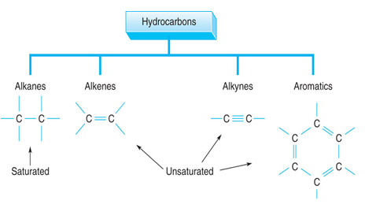
Hydrocarbon
Hydrocarbons : a compound composed of only carbon and hydrogen. (maybe Cl, Br, I)

Slide 4
Alkanes
Alkanes are a homologous series of saturated
hydrocarbons that contain only carbon -carbon
,and hydrogen single covalent bonds.
• In an alkane molecule, all the outer electrons
of each carbon are used in forming single covalent bonds with four other atoms, hence, alkanes are said to be saturated.
- Alkanes have the general formula CnH2n+2
(where n ≥ 1)

Slide 5
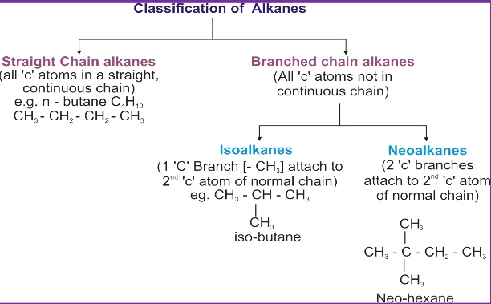
Classification of alkanes

Slide 6
Alkyl Groups
Alkyl group :is formed by removing one hydrogen atom from the alkane chain .The removal of this hydrogen results in change from-ane to –yl to indicate an alkyl group.
general molecular formula for alkyl CnH2n+1
Name: replace -ane ending of alkane with -yl ending
  -CH₃ is “methyl” (from methane)
  -CH₂CH₃ is “ethyl” from ethane

Slide 7
Types of Alkyl groups
1. Primary alkyl group : is an alkyl radical in which the carbon atom bearing the unpaired electron is bonded to only one carbon atom.
2. Secondary alkyl group :an alkyl radical in which the carbon atom bearing the unpaired electron is bonded to two carbon atoms.
3. Tertiary alkyl group: an alkyl radical in which the carbon atom bearing the unpaired electron is bonded to the three other carbon atoms.

Slide 8


Isopentyl
Tertiary pentyl

Slide 9
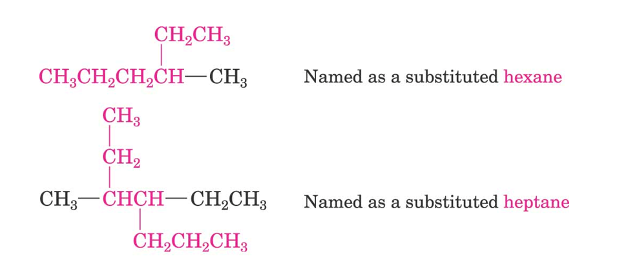
Naming Alkanes:
1. Find the Parent: longest continuous carbon chain

Slide 10
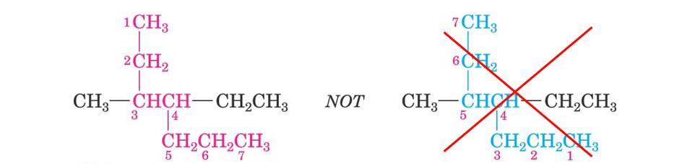
2. Number the atoms in the chain with the end of the chain nearer the first substituent

Slide 11
3. When two or more substituents are present, give each substituent a number corresponding to its location on the longest chain.
The substituent groups should be listed alphabetically (i.e., ethyl before methyl).* In deciding on alphabetical order,

Slide 12
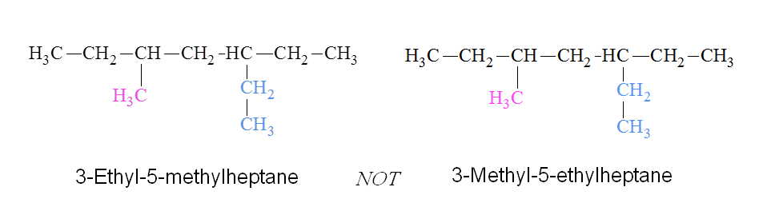

Slide 13
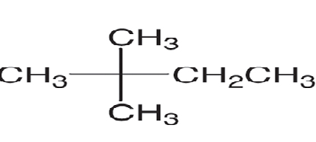
4-When two or more substituents are identical, indicate this by the use of the prefixes di-, tri-, tetra-, and so on. Then make certain that each and every substituent has a number.
2-2-dimethyl butane

Slide 14
PHYSICAL PROPERTIES OF alkanes
1. In normal alkanes, as the no. of C atoms increases, melting point and boiling point .These changes are due to the large surface areas and increased intermolecular forces.
2. Branching alkanes have lower boiling points than
straight chain since the molecules become more compact and the intermolecular forces are reduced
3. Alkanes are insoluble in water, but soluble in non
polar solvents like C6H6, CHCI3 etc.
4. First 4 are gases, C5 to C17 are liquids, remaining
are solids.

Slide 15
CHEMICAL PROPERTIES OF ALKANES
Alkanes are generally unreactive
This is because alkane molecules contain
single carbon-carbon covalent bonds (C-C) and
single carbon-hydrogen covalent bonds (C-H)
which are strong and require a lot of energy
to break.

Slide 16
Reaction of alkanes
1-combustion
Complete combustion
Alkane + oxygen carbon dioxide + water
vapour
The reaction is highly exothermic and a large
amount of heat energy is released.
This is why alkanes make good fuels.

Slide 17
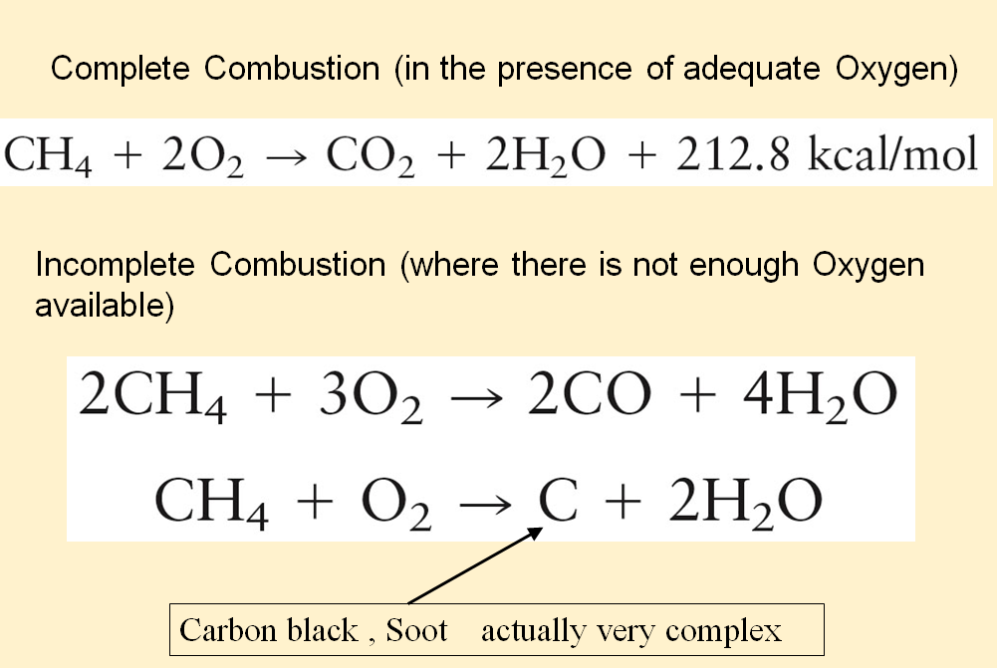

Slide 18
2-Halogenation Reactions
Alkanes react with halogens(F2,CL2,Br2,I2)by a process called substitution reaction in which a halogen atom substitutes for a hydrogen atom .This type of reaction is called halogenation,and the products are haloalkanes(alkyl halides).
Reaction is initiated by sunlight or U.V. light or by heating which provides the energy to break the covalent bond in the chlorine molecule to produce chlorine atoms.

Slide 19
Mechanizem of halogenation
CI2 molecule absorbs energy; bond breaks
homolytically to give chlorine free radicals.
Chain Propagation step – Chlorine free radical is
highly reactive. It abstracts a H atom of CH4 and
forms Methyl free radical and HCI.

Slide 20
Methyl free radical attacks chlorine to form CH3CI and Chlorine free radical.
These steps are repeated many times. Overall
reaction is.

Slide 21
Chain termination step – After some time, reaction stops due to combination of free radicals.
May further get chlorinated.

Slide 22
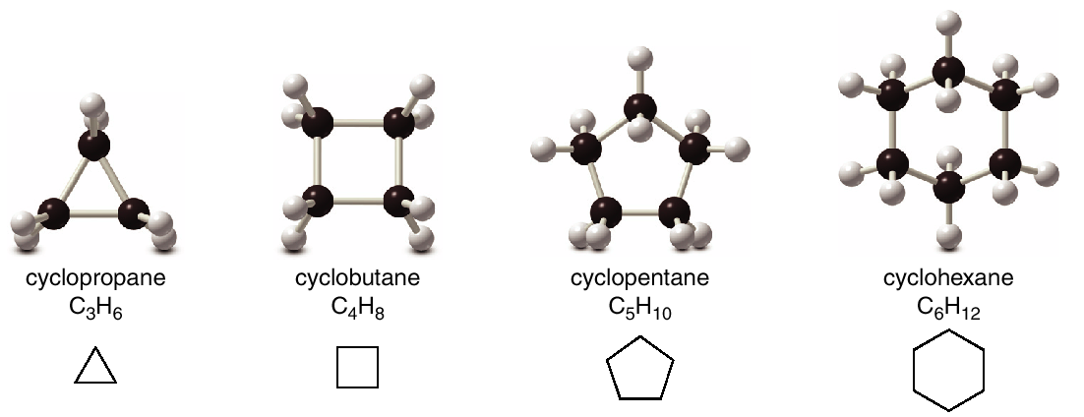
Cycloalkanes
Cycloalkanes are saturated since all the carbon atoms that make up the ring are single bonded to other atoms.
Because of the ring, a cycloalkane has two fewer hydrogens than an acyclic (noncyclic) alkane with the same number of carbons. The general molecular formula for cycloalkanes is CnH2n

Slide 23
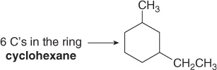

Naming Cycloalkane
1. Find the parent cycloalkane.
2. Name and number the substituents. No number is needed to indicate the location of a single substituent.

Slide 24
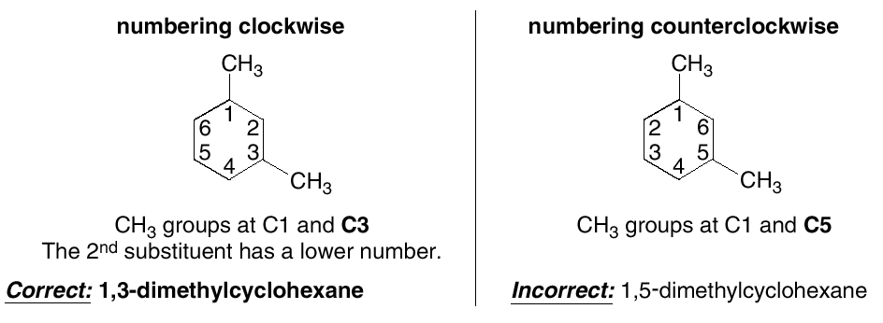
3-For rings with more than one substituent, begin numbering at one substituent and proceed around the ring to give the second substituent the lowest number.

Slide 25
Isomerism
What is Isomerism?
The organic compounds having the same molecular formula but different structures are known as Isomers. This phenomenon is known as Isomerism.
In other words, the organic compounds having the same molecular formula but different arrangements of carbon atoms in them, are known as Isomers.

Slide 26
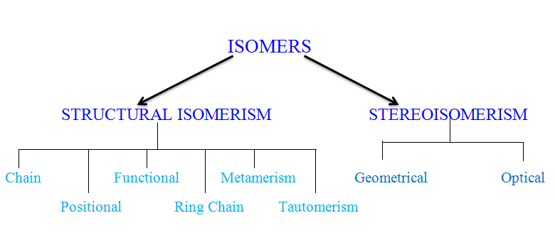
Classification of isomerism

Slide 27

1. CHAIN ISOMERISM
The same molecular formula represents two or more compounds.
It differs in the nature of carbon chain(straight or branched)
Example, C4H10 (Butane) has two isomers namely butane and 2-methylpropane.

Slide 28

2. POSITIONAL ISOMERISM
It differs in the position of the same functional group
the basic carbon skeleton remains unchanged, but important groups are moved around on that skeleton.

Slide 29
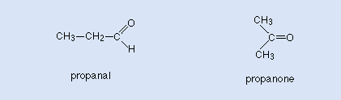
3. FUNCTIONAL ISOMERISM
Are structural isomers that have the same molecular formula (that is, the same number of atoms of the same elements), but the atoms are connected in different ways so that the groupings are dissimilar. These groups of atoms are called functional groups.

Slide 30
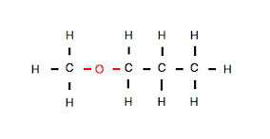
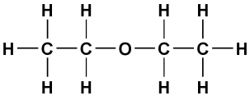
4. METAMERISM ISOMERISM
It differs in the nature of the alkyl groups attached to the same functional group.
Example, Diethyl ether and Methyl propyl ether are metamerical isomers.
Diethyl ether Methyl propyl ether

Slide 31
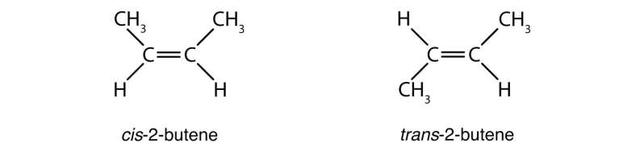
GEOMETRICAL ISOMERISM
The same molecular formula represents two or more compounds
It differs in the spatial arrangement of atoms or groups around
Carboncarbon double bond.
It is of two types-If same group are on same side then, it is called ‘cis’
isomers and if it is on opposite sides, then it is called ‘trans’ isomers.
Example, cis-2-butene and trans-2-butene are ‘cis’ and ‘trans’ isomers.

Slide 32
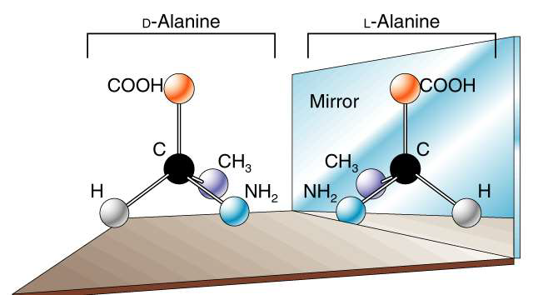
OPTICAL ISOMERISM
Optical isomers: are two compounds which contain the same number and kinds of atoms, and bonds (i.e., the connectivity between atoms is the same), and different spatial arrangements of the atoms, but which have non-superimposable mirror images.
Example, d-Alanine and l-Alanine.

